Slide 1

KALERWE
S.D.A Hymnal 612
4 ~ Verses
65.
Kale Ggye Lya Yesu, Mugolokoke.…
~
Onward, Christian Soldiers!…

Slide 2

1 of 4 verses
Kale ggye lya Ye-su,
Mugolokoke,
Mulabe Mukama
akulembedde;
Mu balabe ba-ngi
Yesu mugabe;
Mukam(a) atuyi-ta;-
tugende naye.

Slide 3
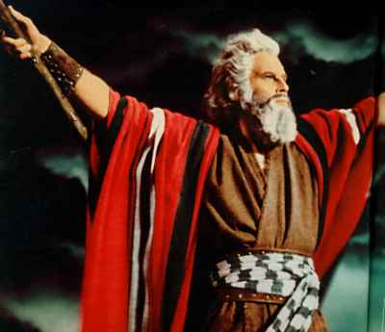
1 of 4 verses
Chorus:
Kale ggye lya Ye- - su,-
Mugolokoke,
Mulabe Mukama
Akulembedde.

Slide 4
2 of 4 verses
Tugende mu maa-so,
ng’abalwanyi be;
Tusinge Setani n’amagezi ge
Tukkirize Ye-su ye ngabo yaffe,
N’ekitala kya-ffe- kye Kigambo kye.

Slide 5
2 of 4 verses
Chorus:
Kale ggye lya Ye- - su,-
Mugolokoke,
Mulabe Mukama
Akulembedde.

Slide 6
3 of 4 verses
Erinnya lya Ye-su bwe liwulirwa,
(A)baddu ba Setani
bakankana nnyo;
Mmwe mugum(e) emyo-yo,
aboluganda,
Mu Mukama wa-ffe-
tuliwangula.

Slide 7
3 of 4 verses
Chorus:
Kale ggye lya Ye- - su,-
Mugolokoke,
Mulabe Mukama
Akulembedde.
.

Slide 8
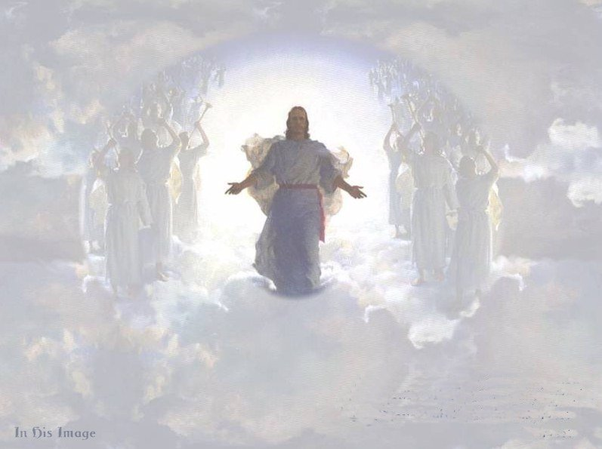
4 of 4 verses
Mu bayite ba-ngi bagende naffe,
Balyoke babeere abasajja be;
Kal(e) abolug-anda,
tugum(e) emyoyo,
Omugabe wa-ffe -ye wa maanyi nnyo

Slide 9
4 of 4 verses
Chorus:
Kale ggye lya Ye- - su,-
Mugolokoke,
Mulabe Mukama
Akulembedde.
.

